Slide 1

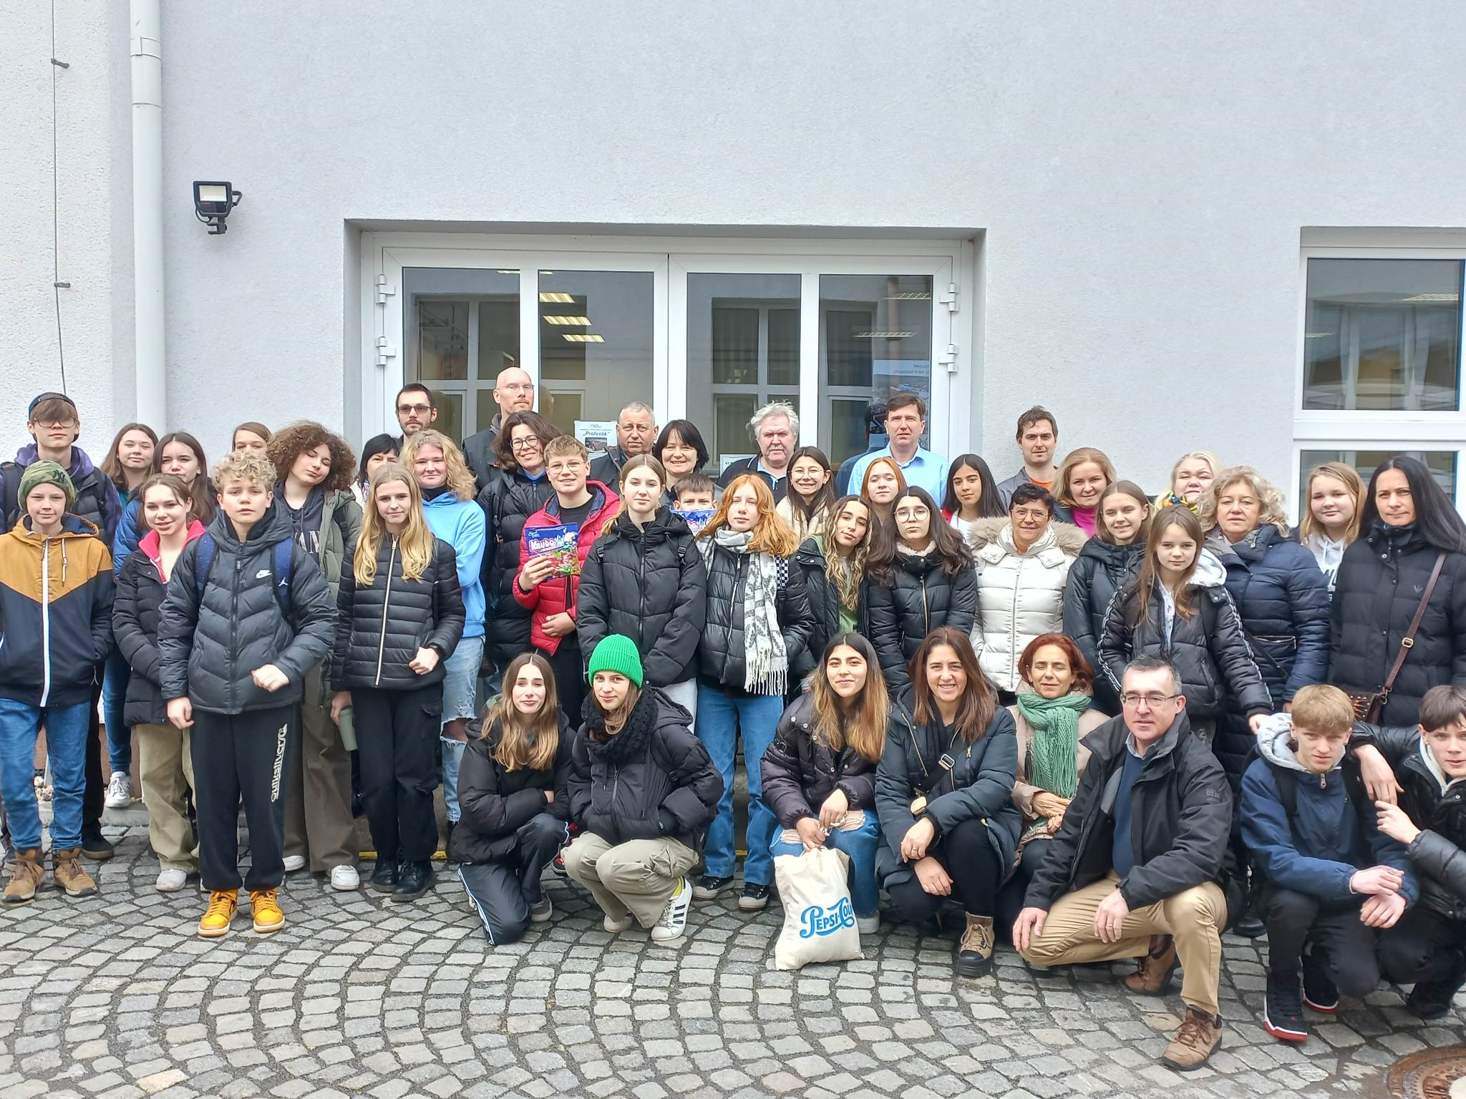

Secondary automotive school in holice car industry☺

Slide 2
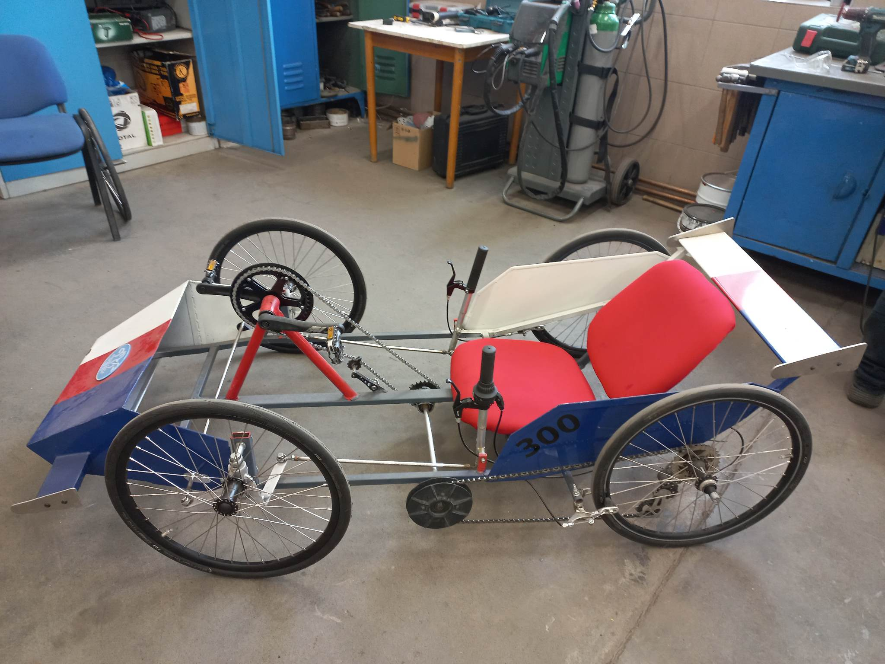
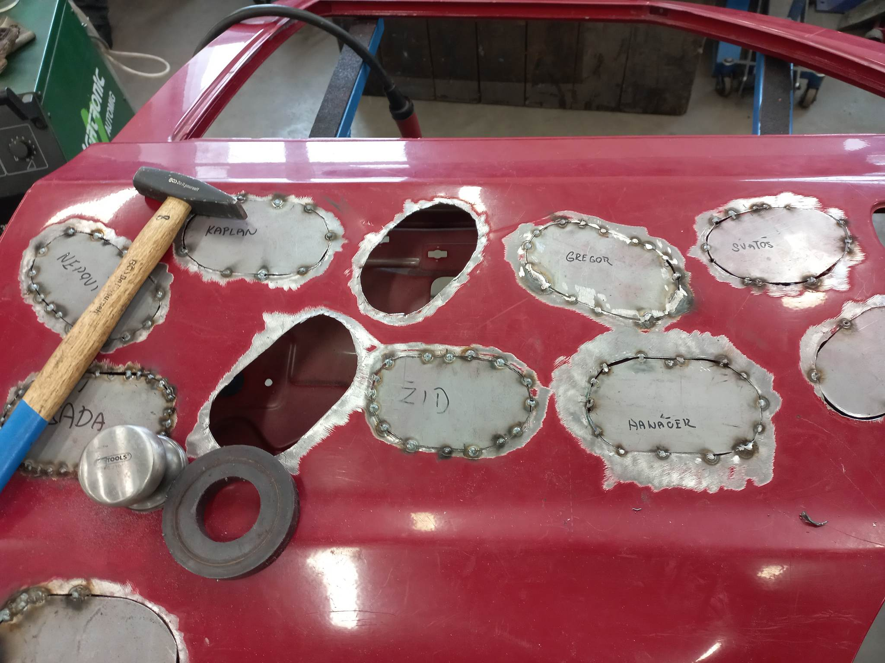
We had an excursion in secondary automotive school in holice. This school prepares students for work in the car industry.

Slide 3
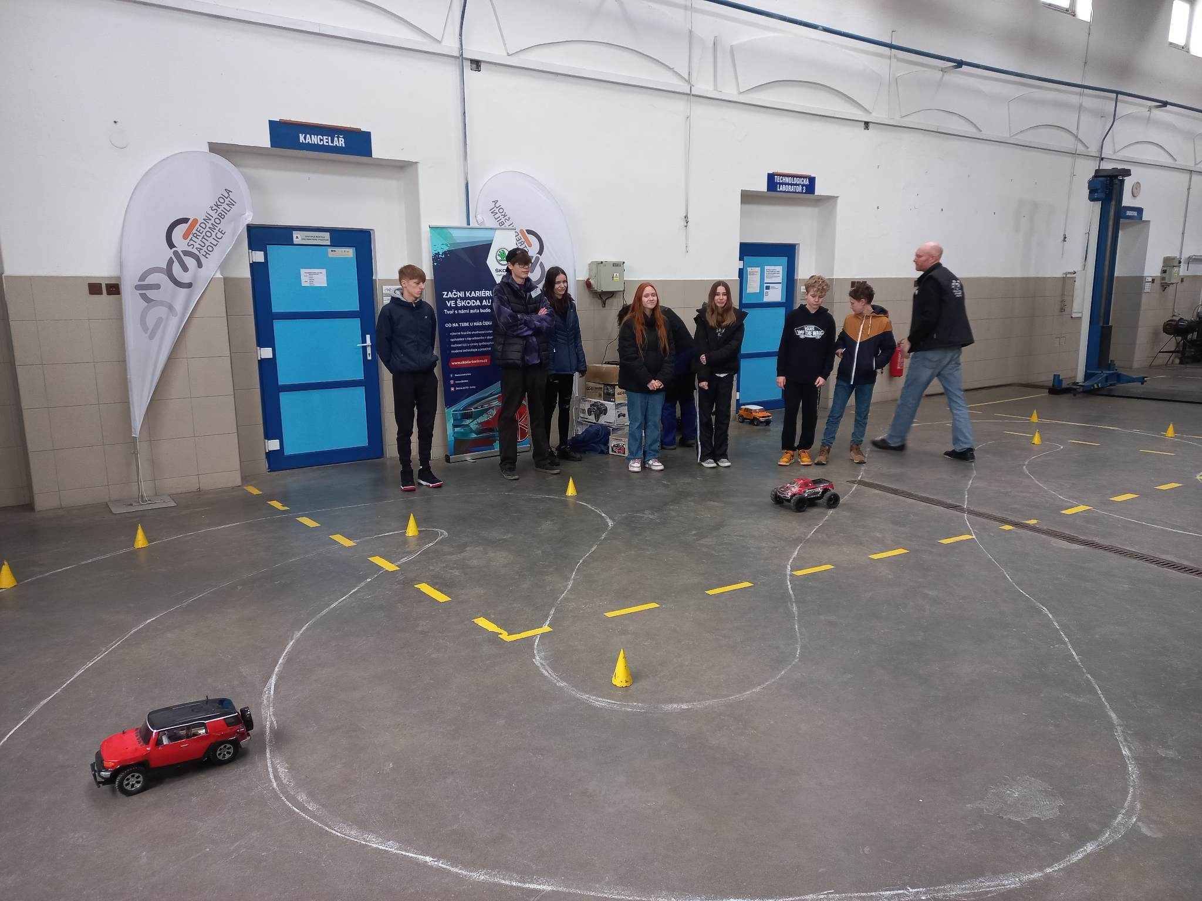
We experienced a lot of new things. Our lecturers and guides showed us around the school. Together we played games. For example we had to drive a remote controlled cars. It was a competition with other groups.

Slide 4
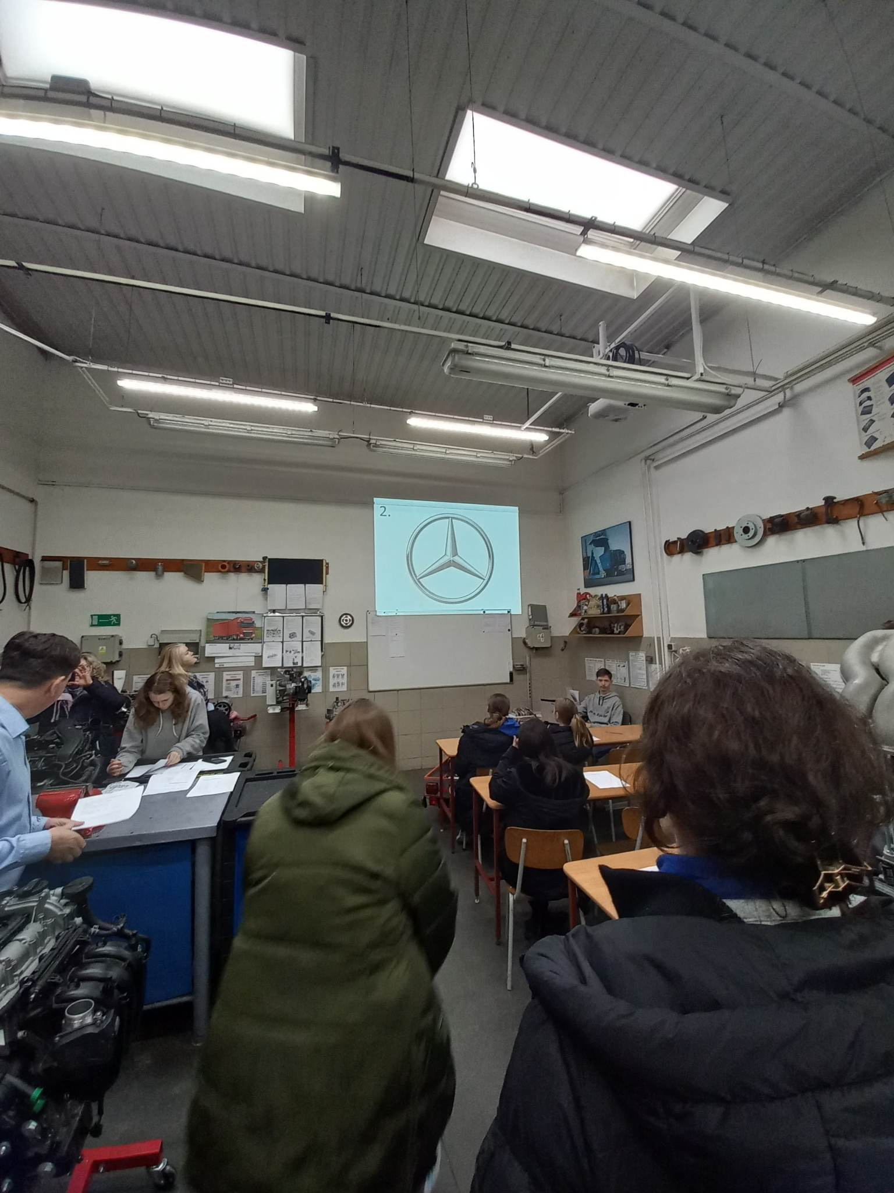
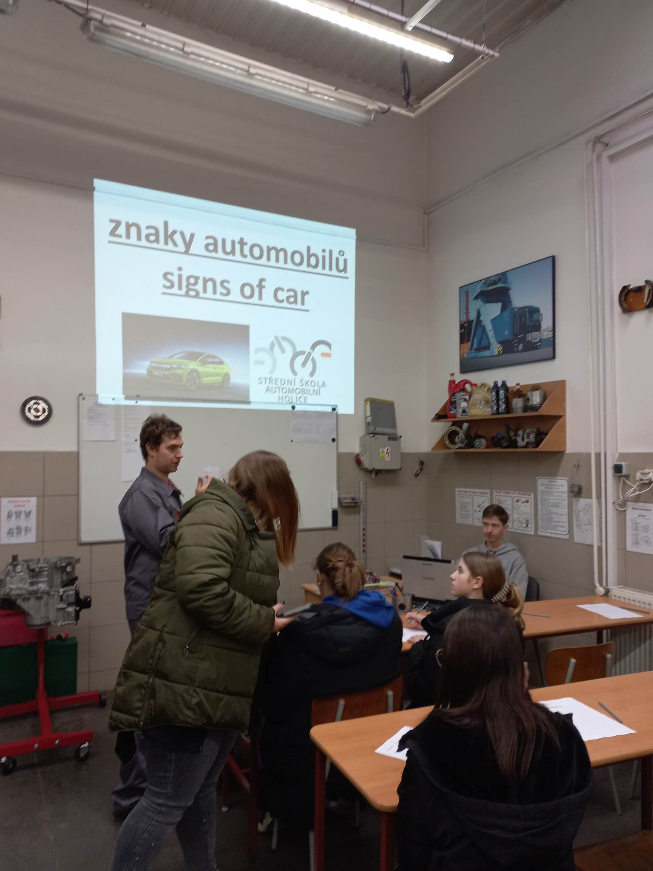
then we had to guess signs of cars. We were pretty good.
☺☺☺

Slide 5

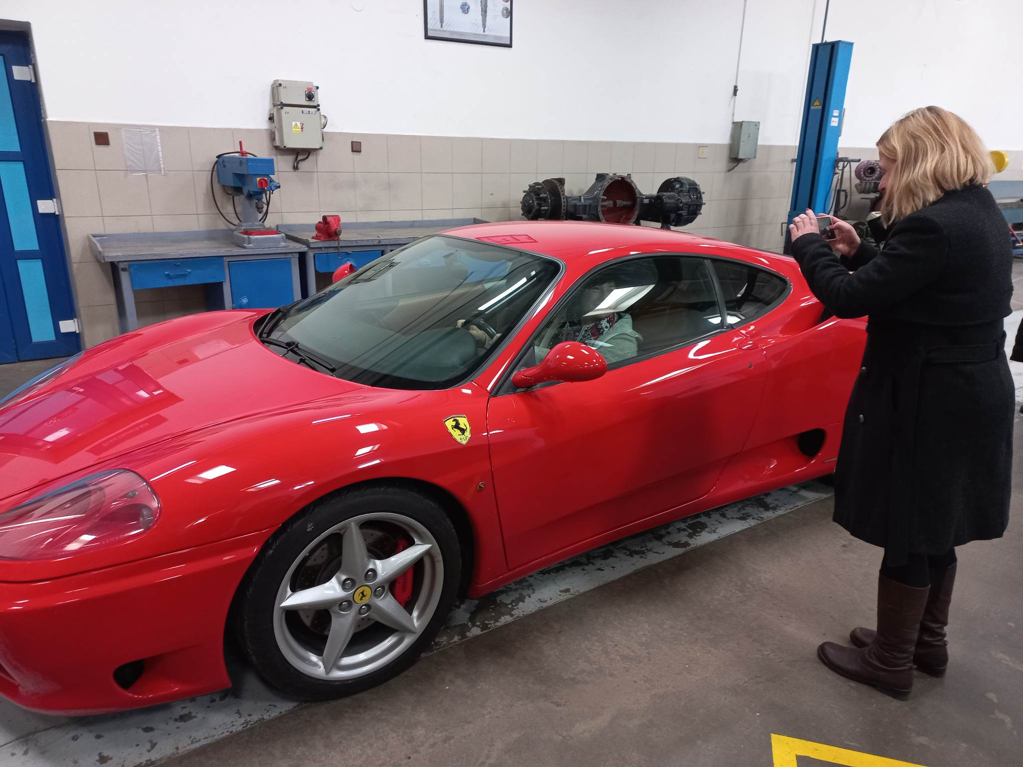
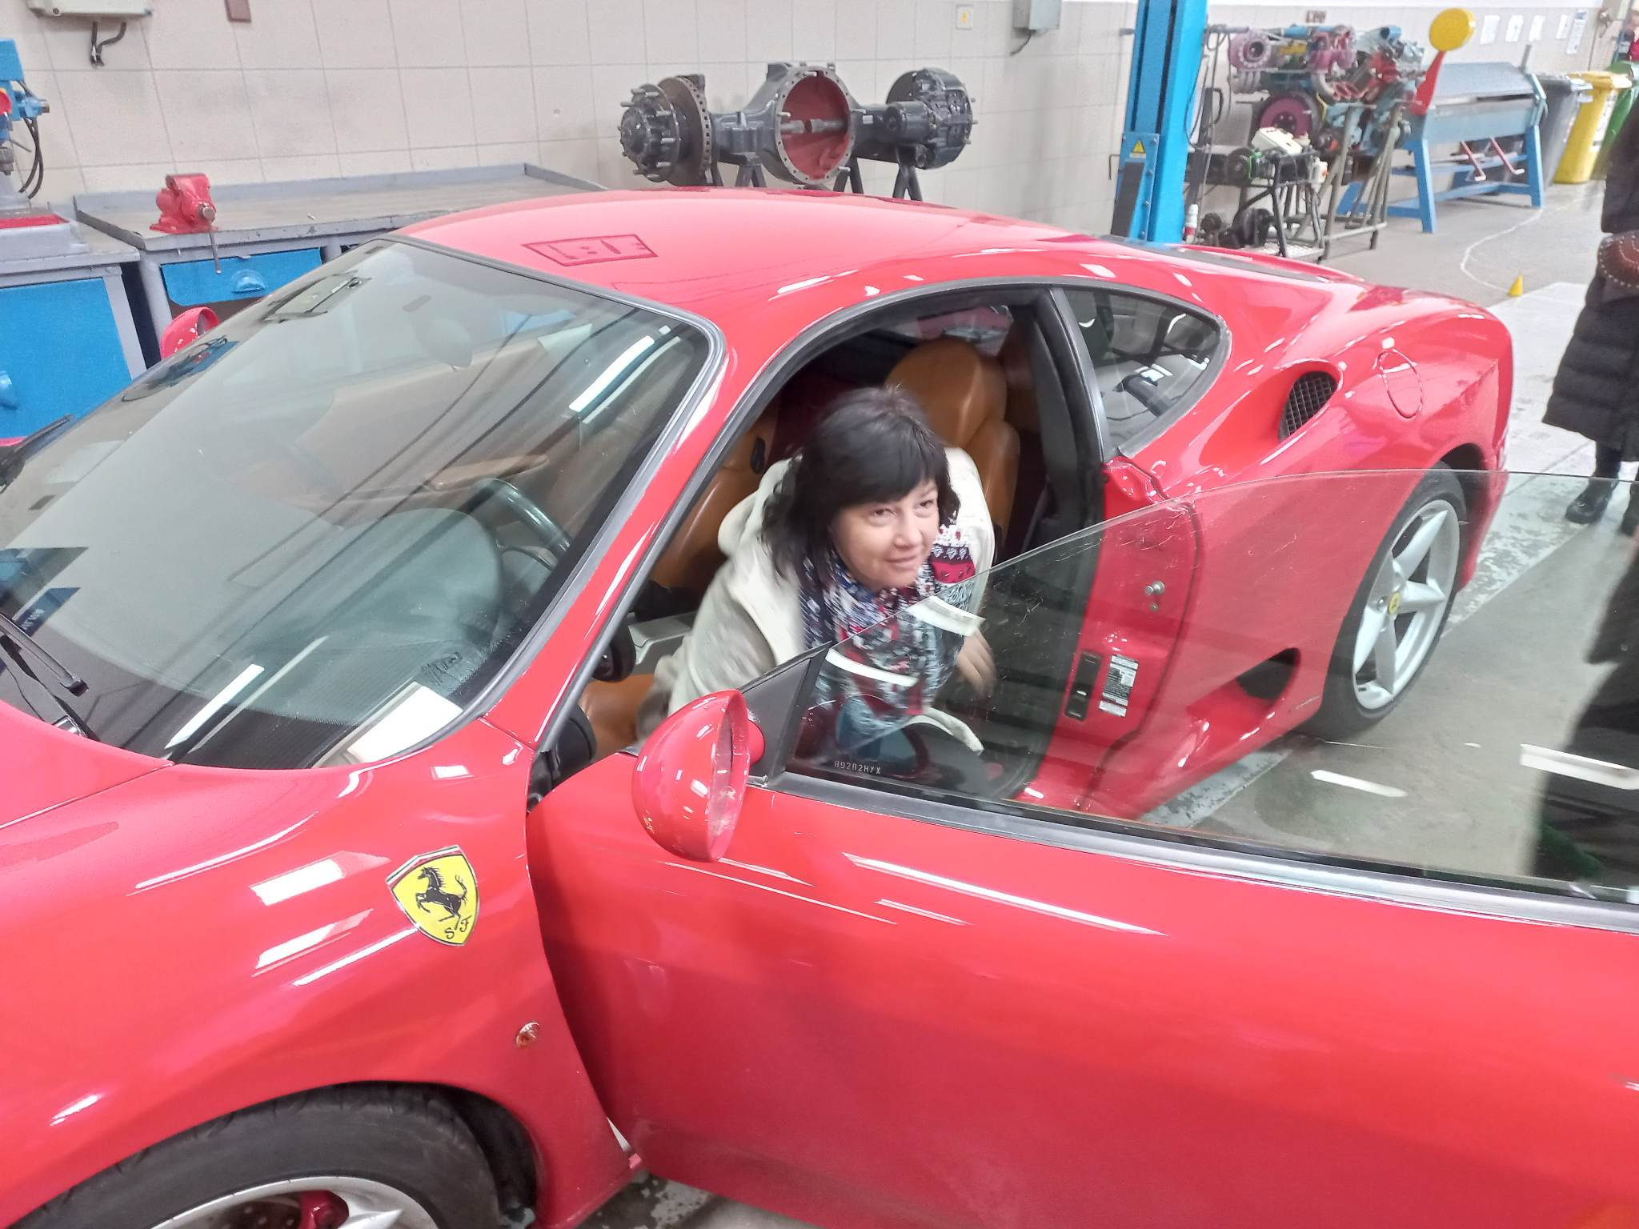
We could sit in ferrari. Wow!!!

Slide 6
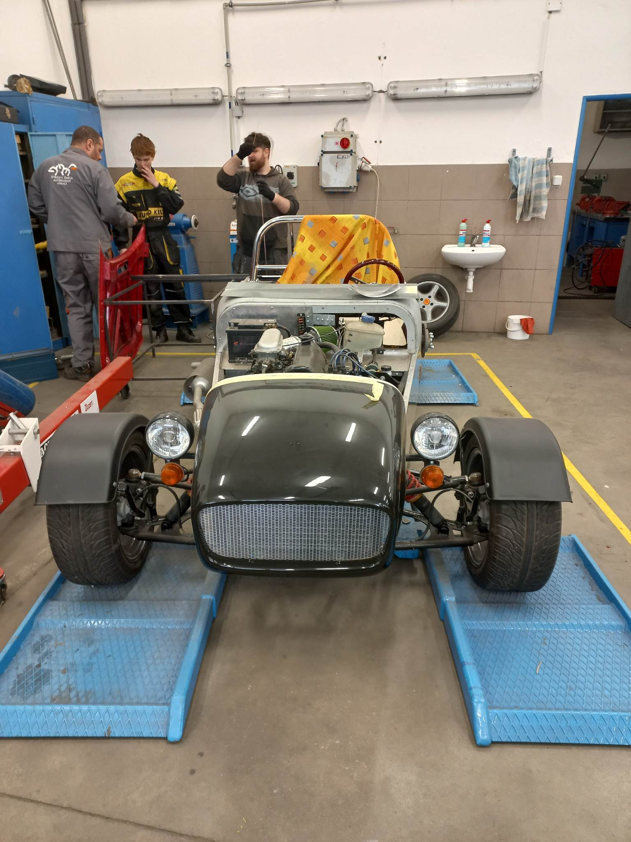
Pedal cars

Slide 7
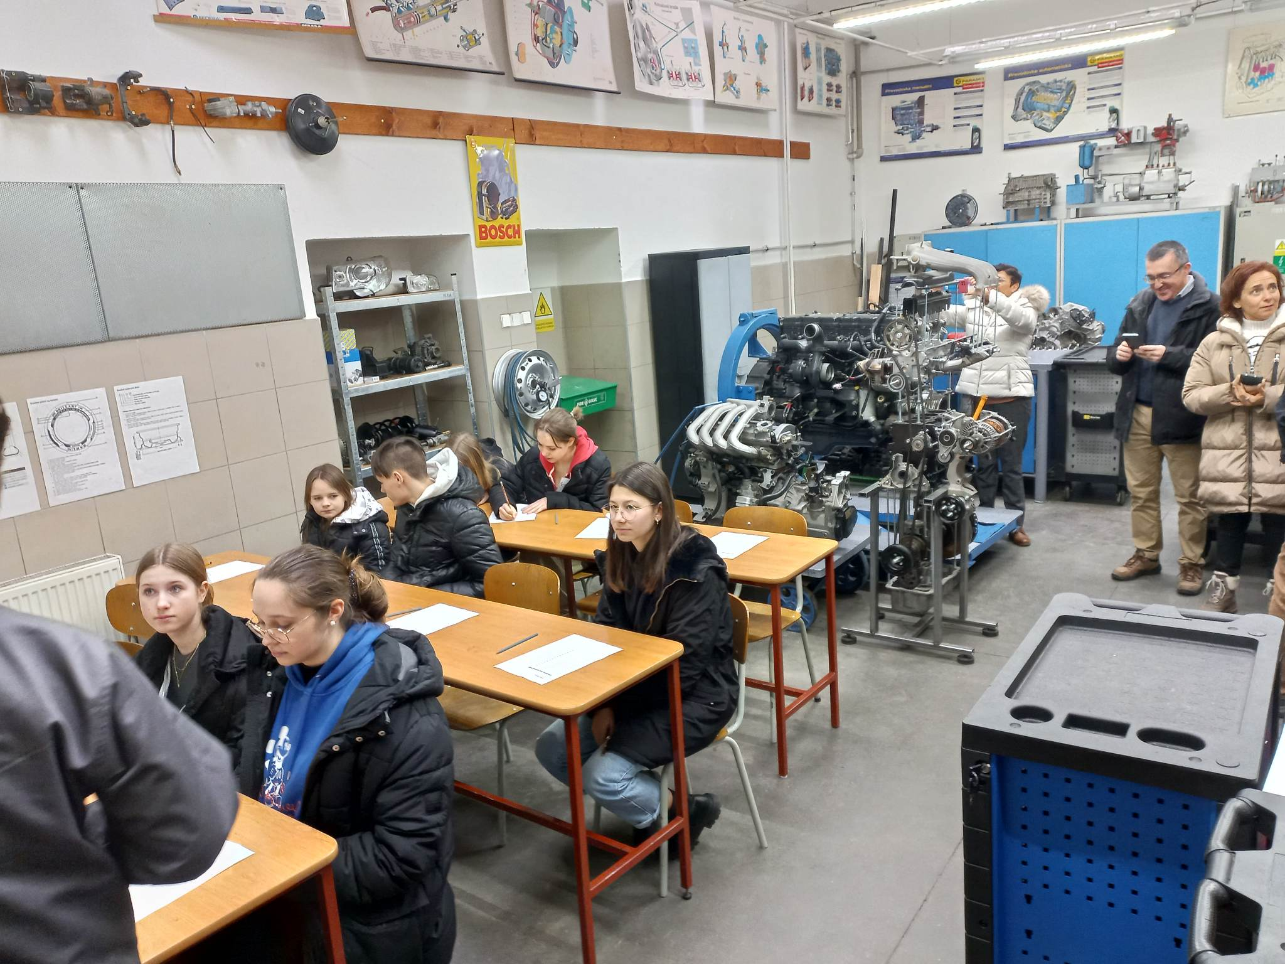
We learned about parts of a car

Slide 8
Thank you for attention
"The European Commission support for the production of this publication does not constitute an endorsement of the contents which reflects the views only of the authors, and the Commission cannot be held responsible for any use which may be made of the information contained therein."

